Slide 1
Batch Edit (Multiple Samples)

Slide 2
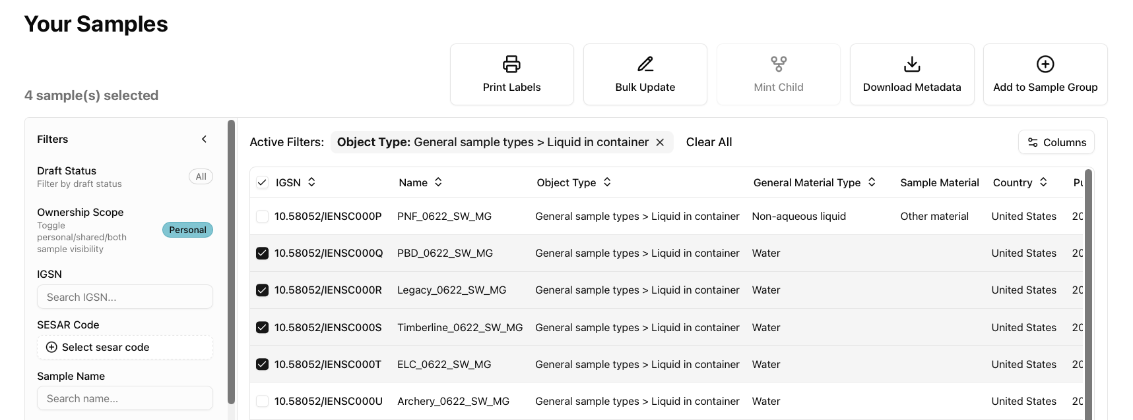
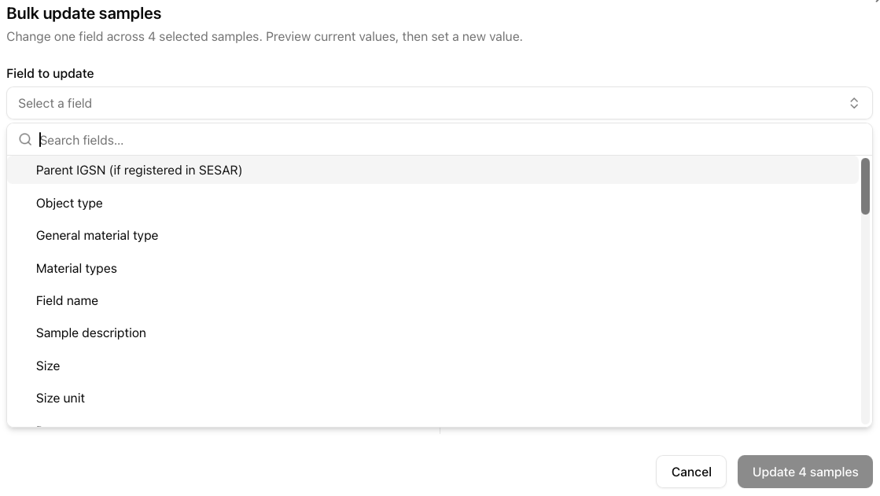
Batch (Bulk) Update
Select the samples you want to batch update.
Click Bulk Update.
Select the Field to update from the drop-down menu.

Slide 3
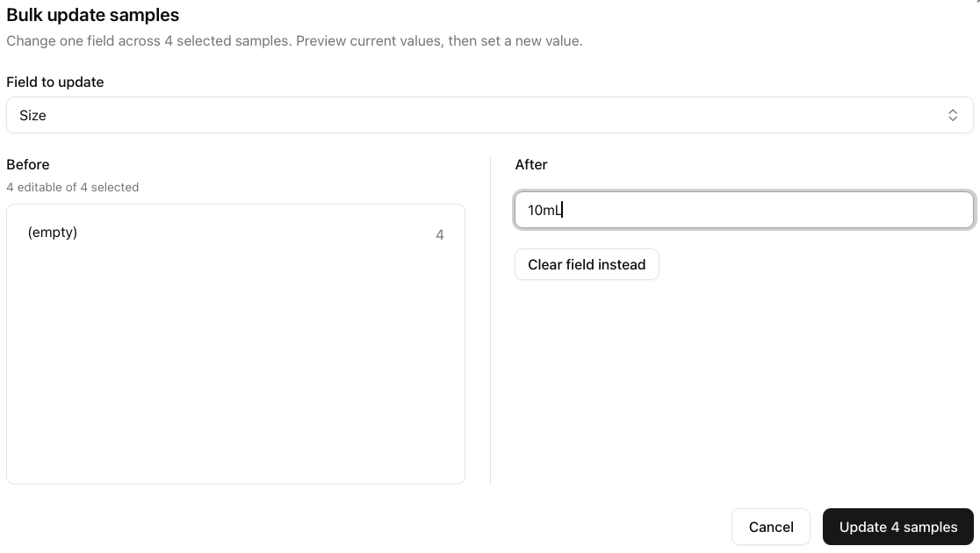
Batch (Bulk) Update
Before shows you the current information that is associated with the sample.
Add content (if free text) or apply controlled vocabulary (drop down) in After.
Once you update the After, click Update X samples.

Slide 4
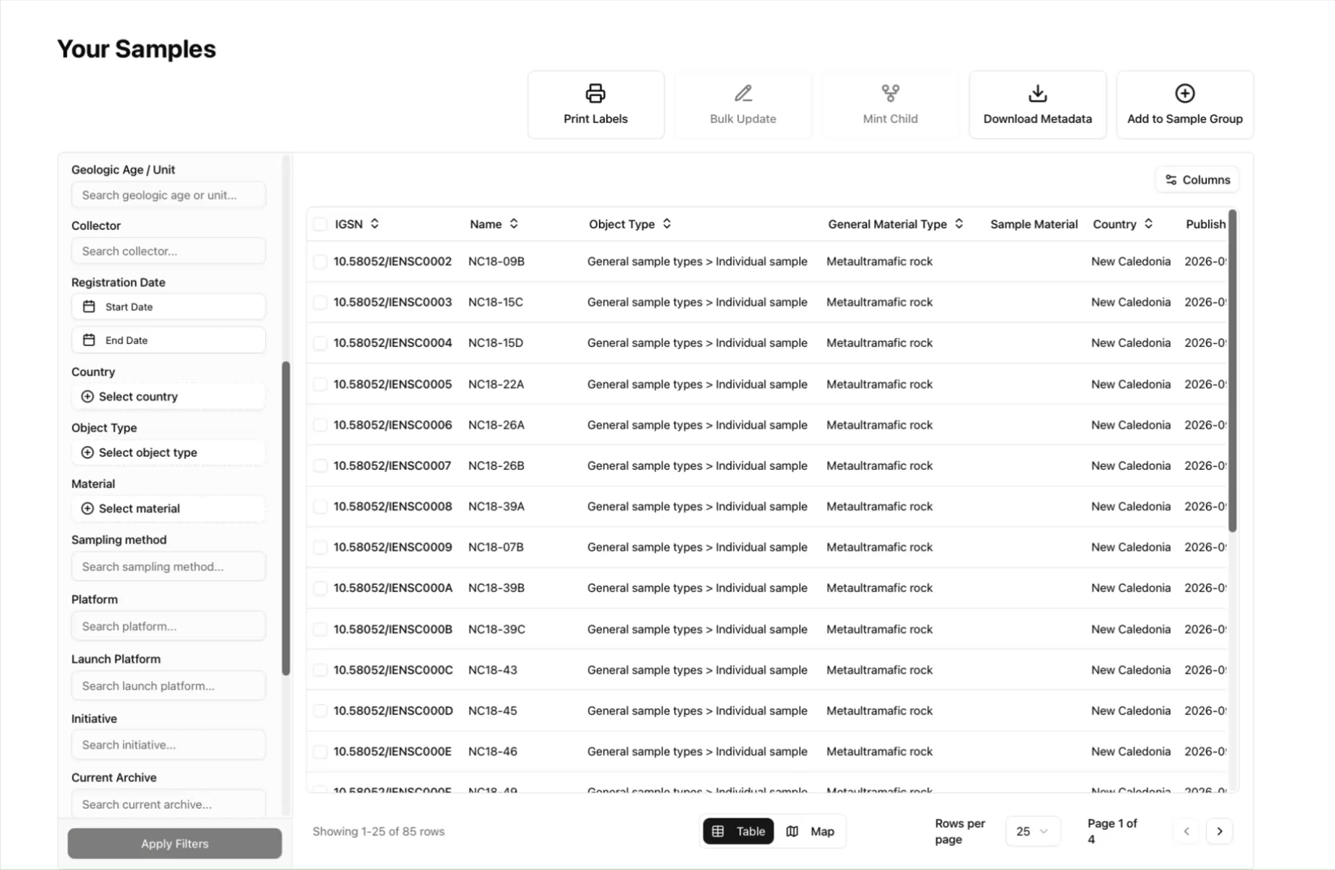
VIDEO Tutorial

